Slide 1

Heartbeat Audio Classification
Advanced Machine Learning Project
Presentation by:
Team1: Nittala Venkata Sai Aditya, Disha Gandhi, Sai Bhargav Tetali, Vishwak Venkatesh and Soumith Reddy Palreddy
Notes:
Hello all lets have a heart to heart conversation today – I know plenty of my friends here who smoke/drink - lets think about our hearts today!

Slide 2





Meet the Team
Nittala Venkata Sai Aditya
Disha Gandhi
Soumith Palreddy
Vishwak Venkatesh
Sai Bhargav
Notes:
Here’s the team Aditya – Disha – vishwak and sai Bhargav – and myself

Slide 3

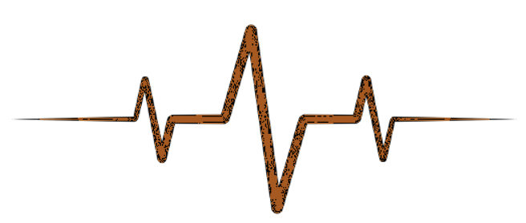
PROBLEM STATEMENT
This is a heartbeat classification problem on ECG signals and how machine learning can be leveraged to classify the heart beats to normal and abnormal situations.
Description
29% of all global deaths are due to cardiovascular diseases. Any method which can help to detect signs of heart disease could therefore have a significant impact on world health.
Why?
Source: http://www.peterjbentley.com/heartchallenge/
Notes:
Our problem statement is to classify the heartbeat audios into normal and various kinds of abnormalities . Why do we want to do this – 29% of all global deaths are due to cardiovascular diseases.

Slide 4

DATASET DESCRIPTION
Dataset A
Dataset B
iStethoscope Pro iPhone app
Train:124 Test: 52
Normal, Murmur, Extra Heart Sound, Artifact
Hospitals Digital stethoscope
Train:461 Test: 195
Normal, Murmur, Extrasystole
Source
Size
Classes
Note: Dataset A is from the general public via the iStethoscope Pro iPhone app. Dataset B is from a clinic trial in hospitals using the digital stethoscope DigiScope
Notes:
This is a publicly available dataset which contains two parts – the first dataset is recorded with the help of an iPhone App – with 124 audio clips labeled which we use for training and validation.
The other dataset is recorded in a conditioned environment at a hospital using a digital stethoscope - this has 461 labeled audio clips and 195unlabeled

Slide 5
Heartbeat Categories
Normal
Extra heart sound
Healthy heart has a distinct lub dub auditory pattern with a good rhythm and the heartbeats are fairly strong
Extra heart sounds are identified by an additional beat. The heartbeats sound as though there is a “galloping noise”
Murmurs
Extrasystole
This sounds as if there is a “whooshing, roaring, rumbling or turbulent fluid” in one of the temporal locations S1 or S2
Characterized as a heart sound which is out of rhythm usually due to extra or skipped heartbeats.
Artifacts
Characterized by wide range of different sounds (feedback squeals and echoes, speech, music and noise). Basically, not a heartbeat
Notes:
Before we get into the EDA of this dataset – it could be helpful to look at what all categories these heart beats fall into

Slide 6
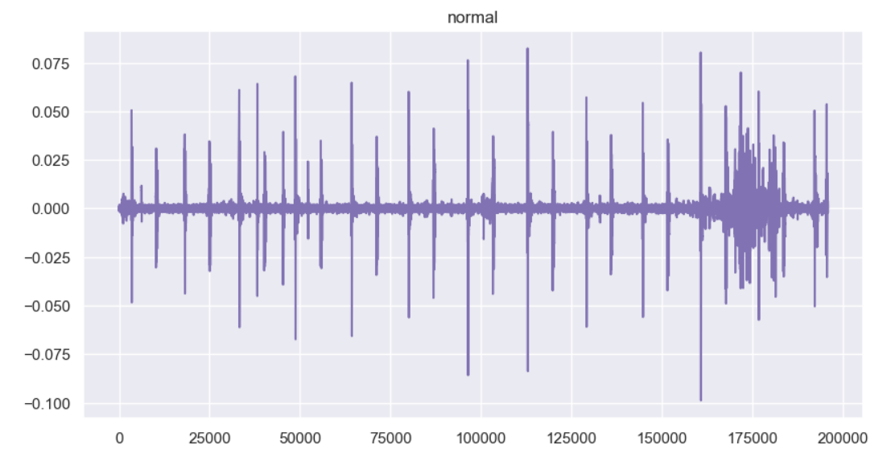
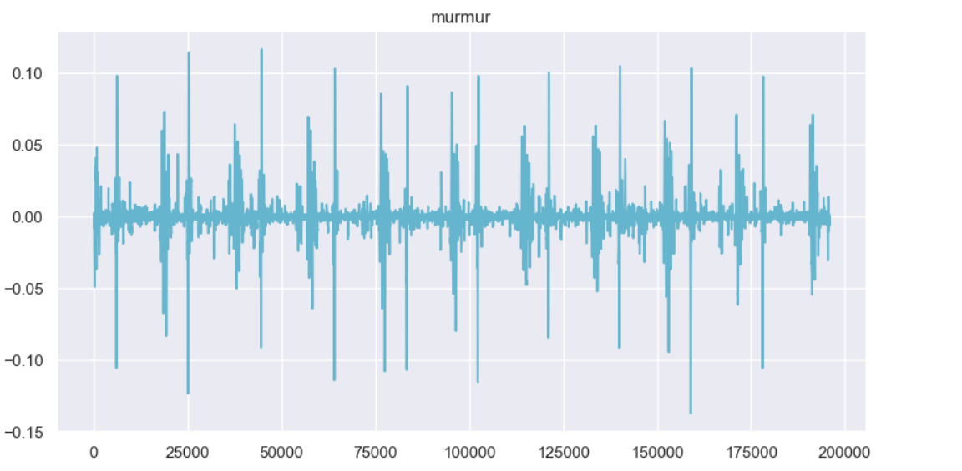
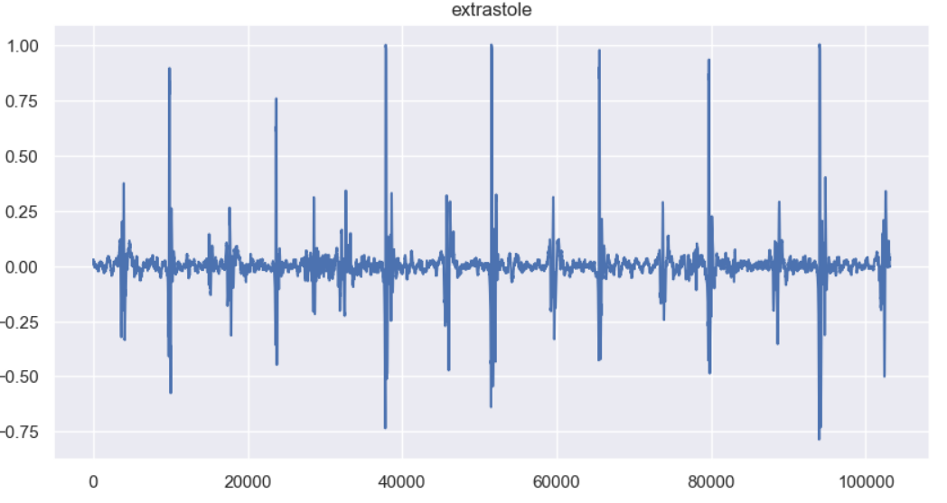
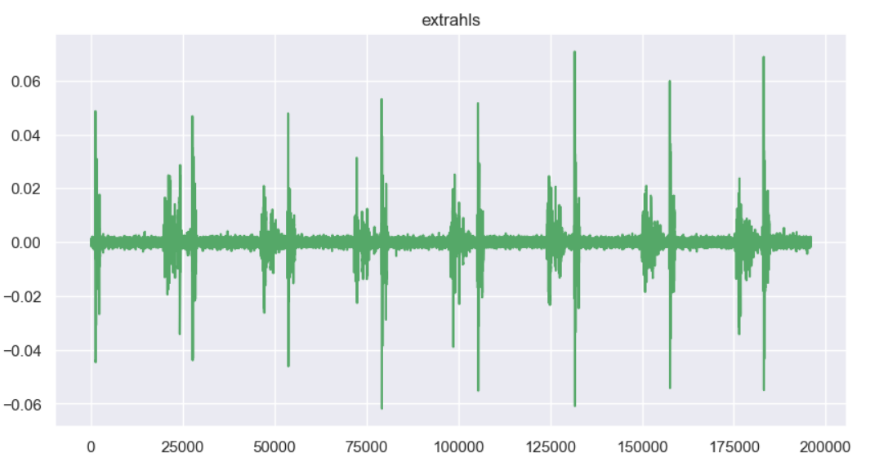
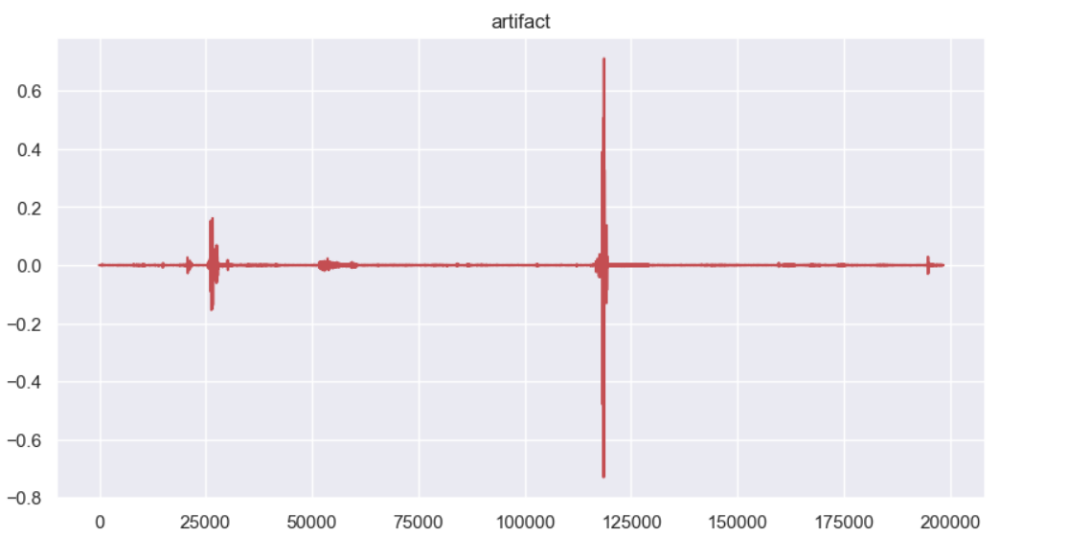
Exploratory Data Analysis – Heartbeat Visualization (1/2)

Slide 7
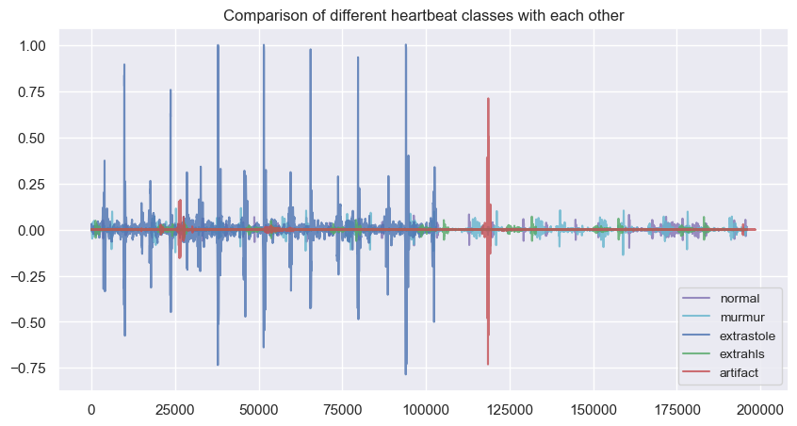
Exploratory Data Analysis – Heartbeat Visualization (2/2)

Slide 8
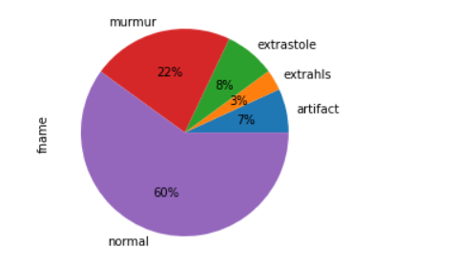
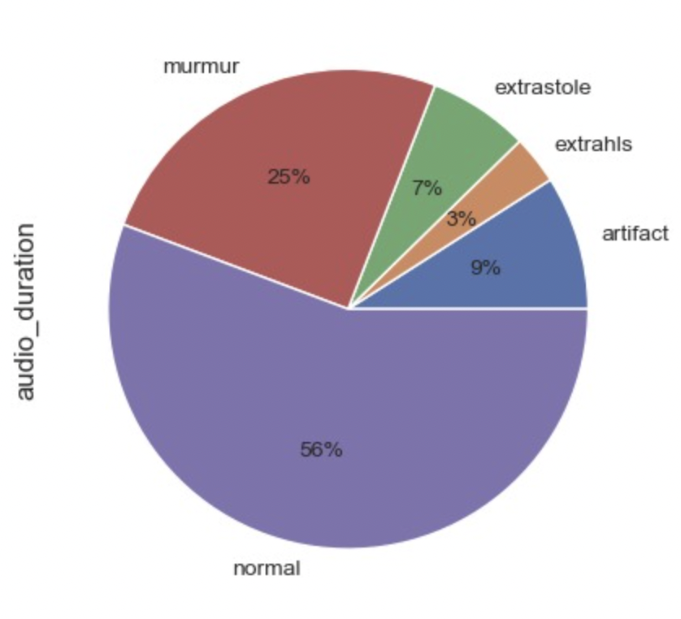
Exploratory Data Analysis – Category Distributions
# of Audio File Distributions
Audio Duration Distributions
CLASS IMBALANCE:
As expected, most of the heartbeats are normal and the most common abnormality is murmurs

Slide 9
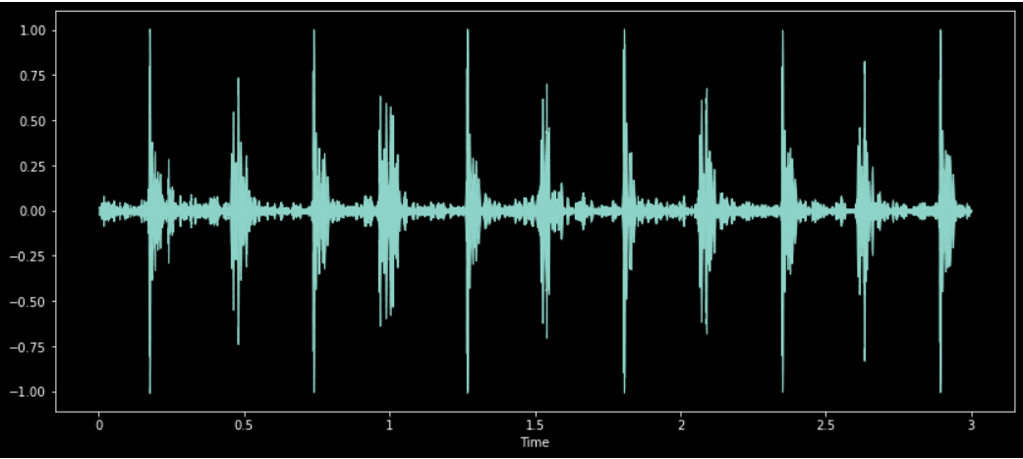
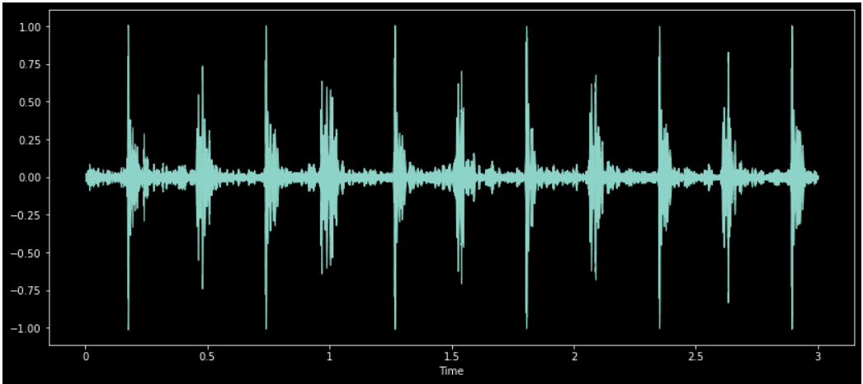
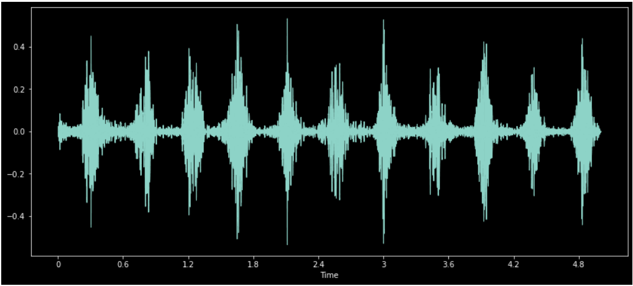
Pre-Processing – Data Augmentation
To increase the size of our dataset, we generate synthetic data using 2 methods:
By adding noise
By changing pitch and speed.
Original Audio File
Noise added in
Audio Slowed & Pitched Down

Slide 10
Pre-Processing – Transformation and Feature Extraction
Transformations
Zero Crossing
Chroma
Augmented Audio Files
162 Features
MFCC
RMS
Melspectrogram

Slide 11
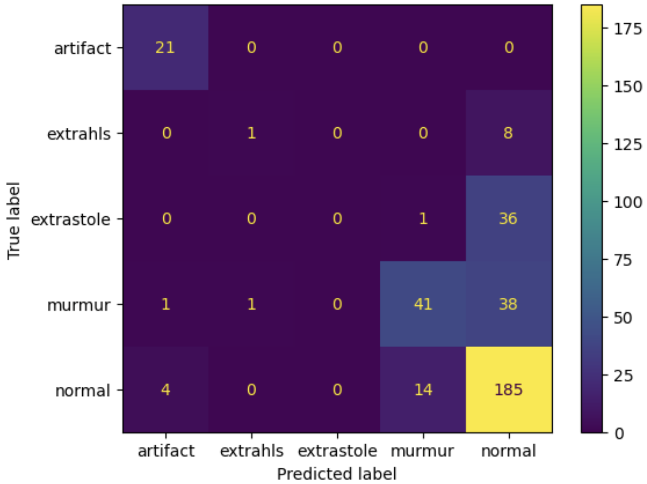
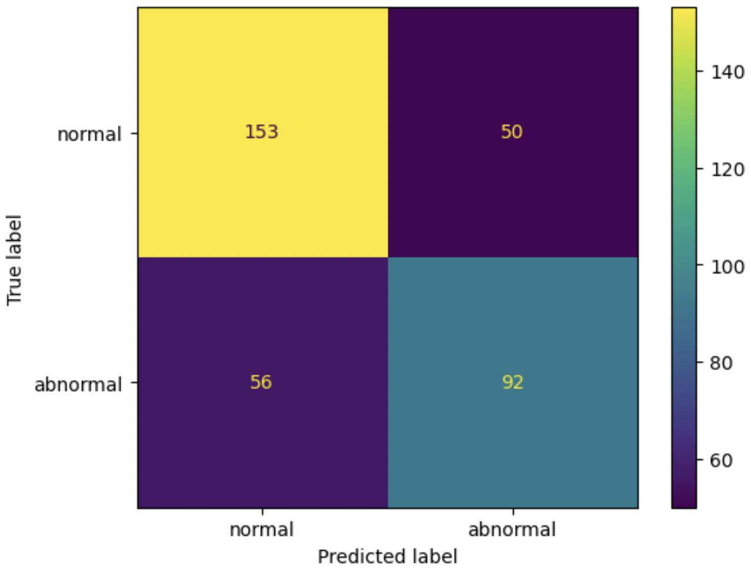
Modeling – Random Forest (Baseline Model)
5 Classes
Binary
Accuracy = 69.80%
Precision = 64.79%
Recall = 62.16%
F1 Score = 63.45%
We chose Random forest model as our baseline and performed Grid Search to get the most
Comments
Accuracy = 70.66%
Notes:
0 is negative(normal), 1 is positive(abnormal)
Focus is on false negatives(hence the recall)

Slide 12
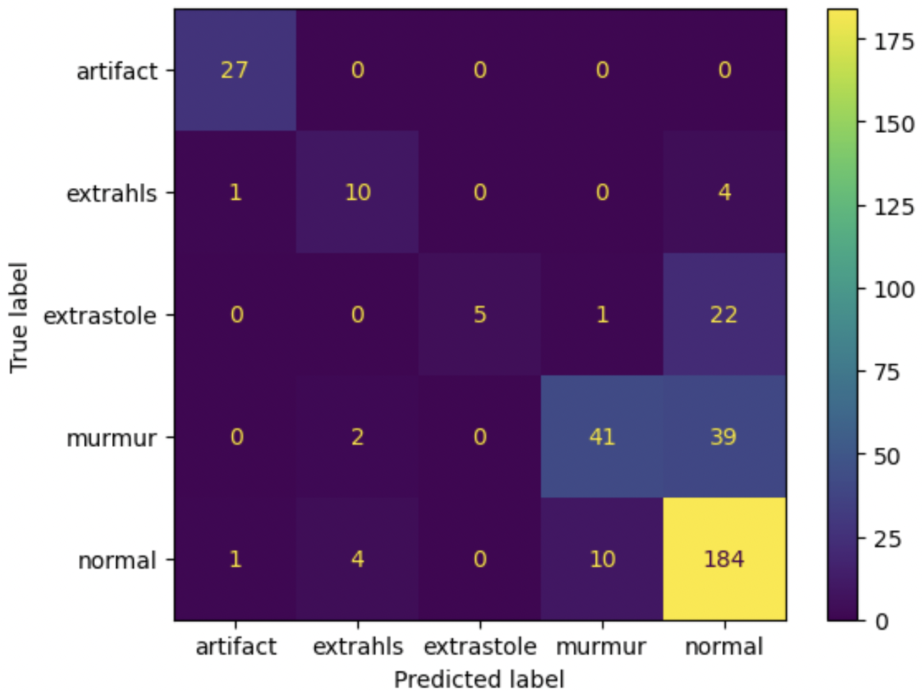
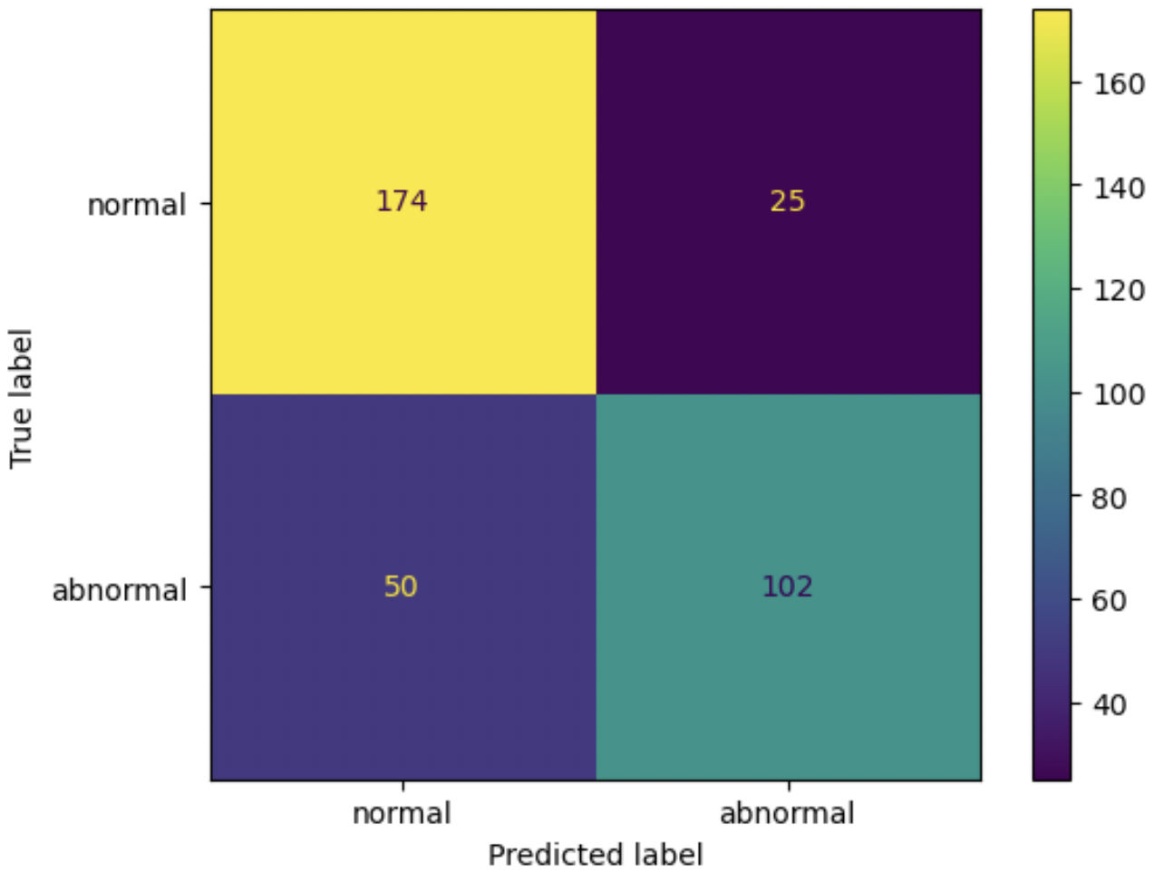
Modeling – Random Forest (Baseline Model) - UpSampled Training Data
5 Classes
Binary
Accuracy = 78.63%
Precision = 80.31%
Recall = 67.11%
F1 Score = 73.12%
UpSampling is done using resample library to remove class imbalance. Max entries in class = 854, Min entries in a class = 42
Comments
Accuracy = 76.07%

Slide 13
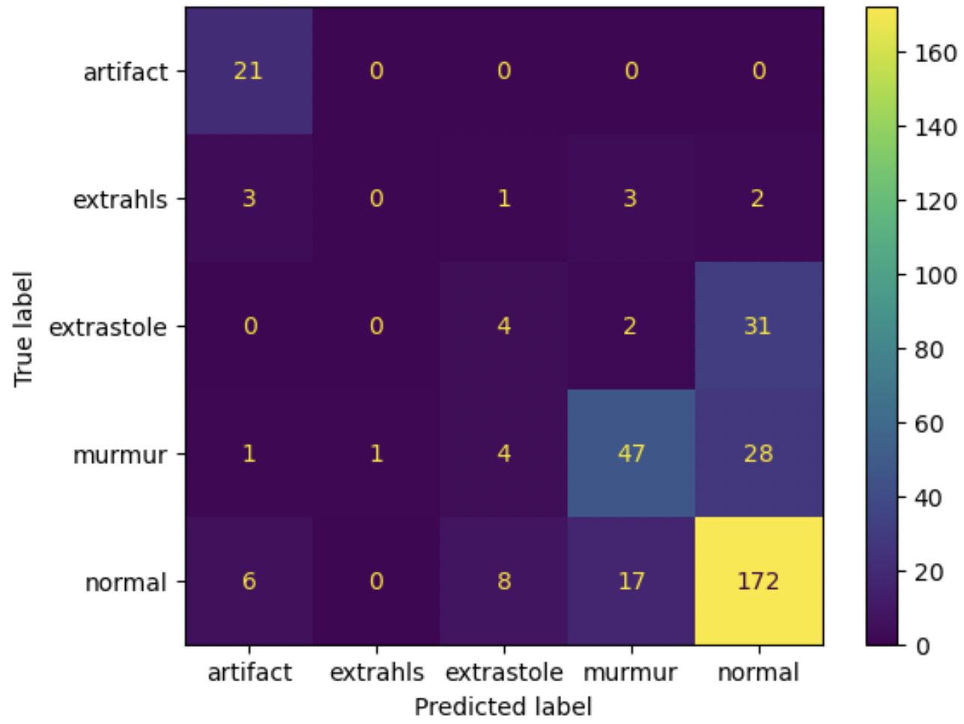

Modeling – LightGBM
5 Classes
Binary
Accuracy = 73.50%
Precision = 73.11%
Recall = 58.78%
F1 Score = 65.17%
Performs bad with higher number of classes,but performs better than the baseline model when the classes are less.
Comments
Accuracy = 69.52%

Slide 14
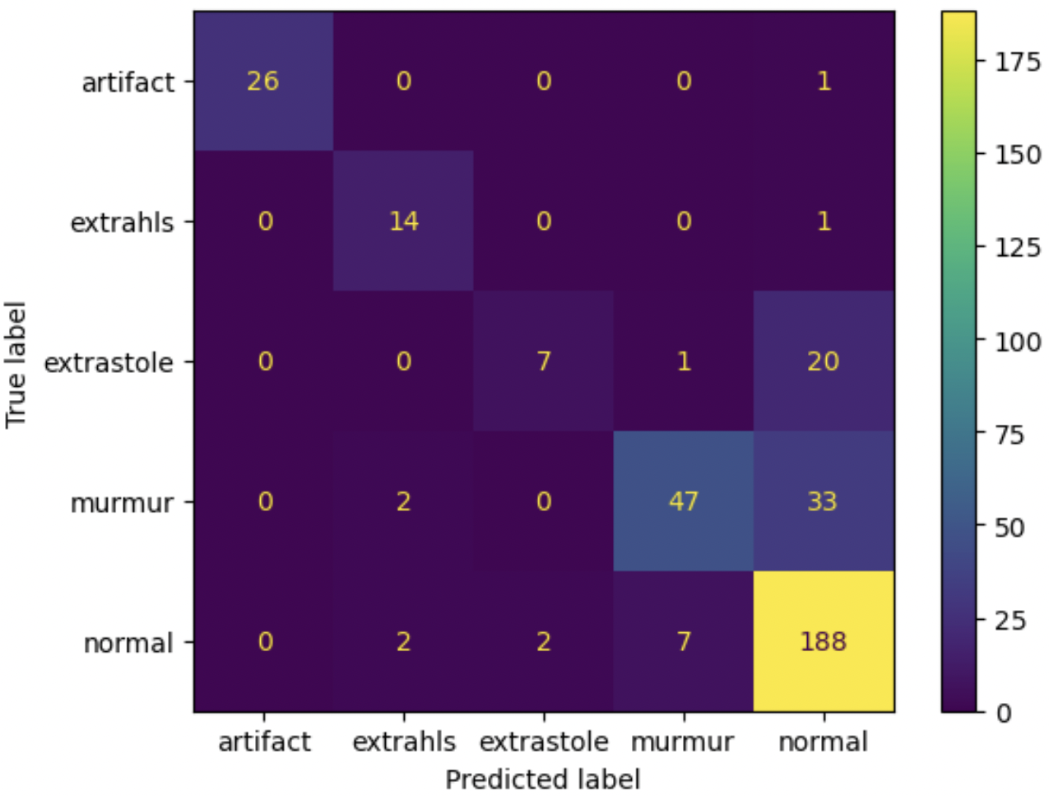
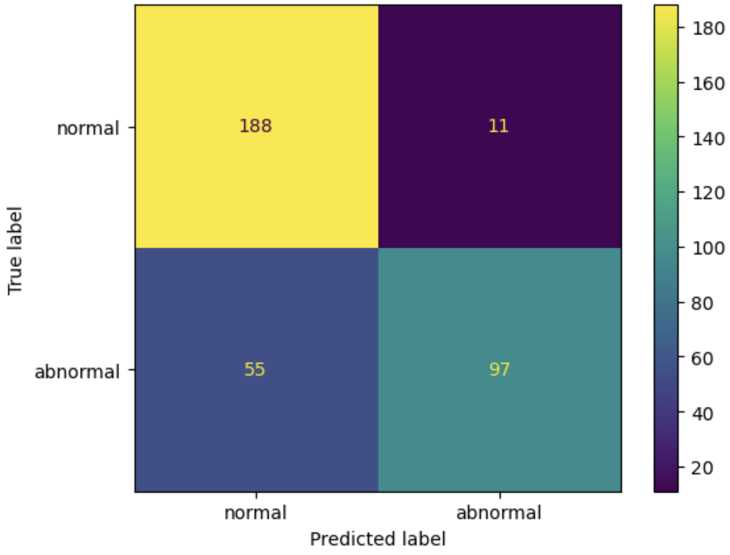
Modeling – LightGBM – UpSampled Training Data
5 Classes
Binary
Accuracy = 81.20%
Precision = 89.81%
Recall = 63.82%
F1 Score = 74.62%
Comparing with the UpSampled baseline model, the performance is quite better. Also, we can see that after UpSampling, the performance for lightGBM is similar irrespective of the number of classes.
Comments
Accuracy = 80.34%

Slide 15
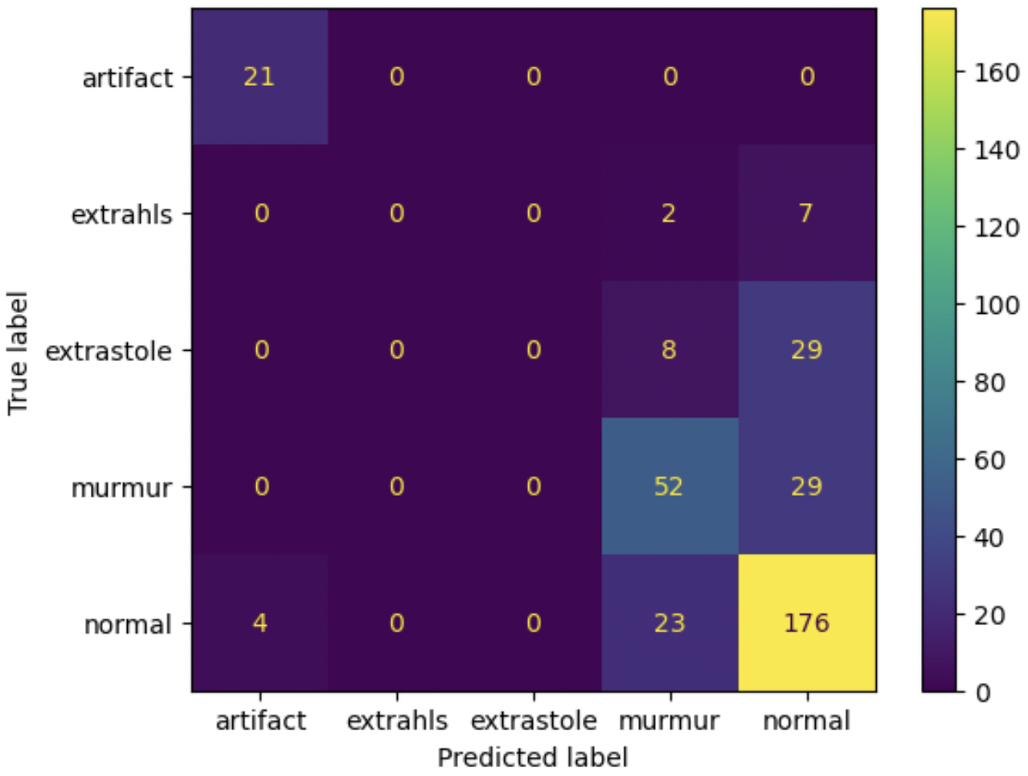
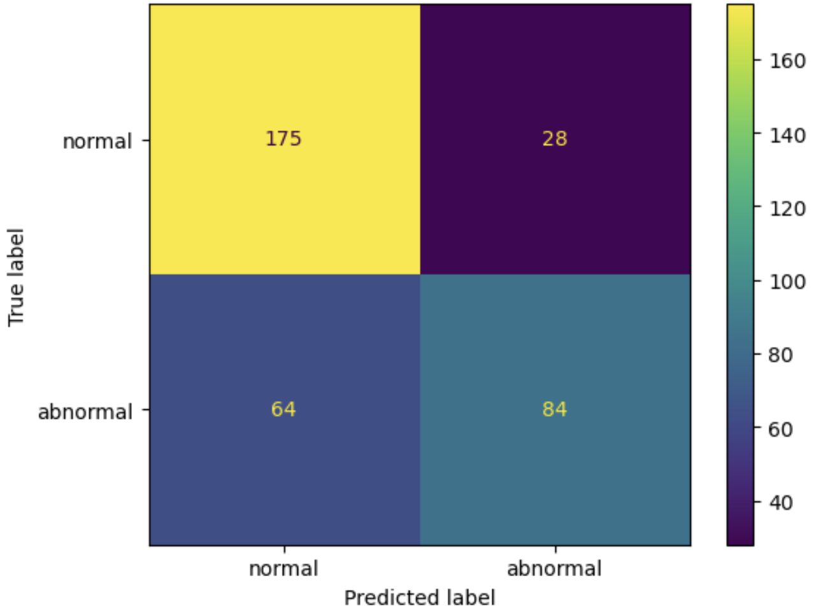
Modeling – CatBoost
5 Classes
Binary
Accuracy = 73.79%
Precision = 75%
Recall = 56.76%
F1 Score = 64.62%
This Model did not perform as well as LightGBM as expected but fared well as compared to the Baseline Model. This took the most time to train after CNN.
Comments
Accuracy = 70.94%

Slide 16
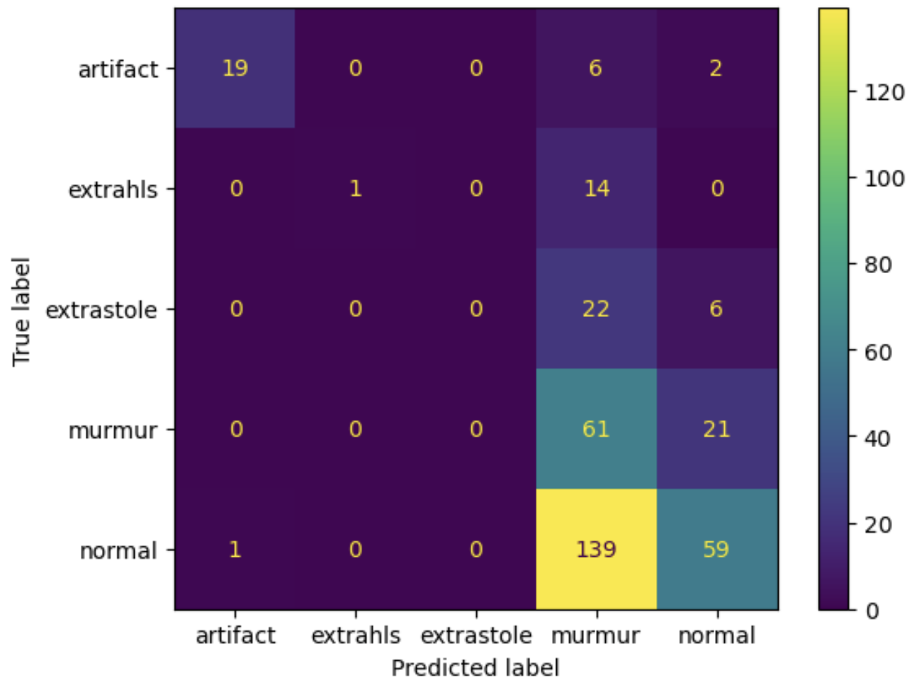
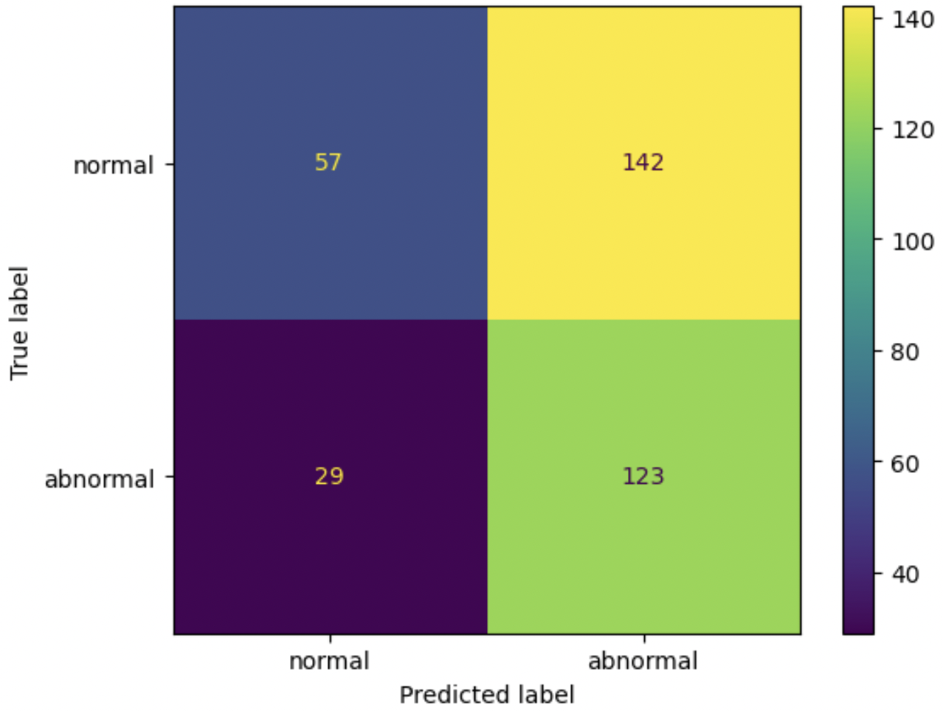
Modeling – CatBoost – UpSampled Training Data
5 Classes
Binary
Accuracy = 51.28%
Precision = 46.42%
Recall = 80.92%
F1 Score = 58.99%
UpSampling degraded the performance.
Comments
Accuracy = 39.89%

Slide 17
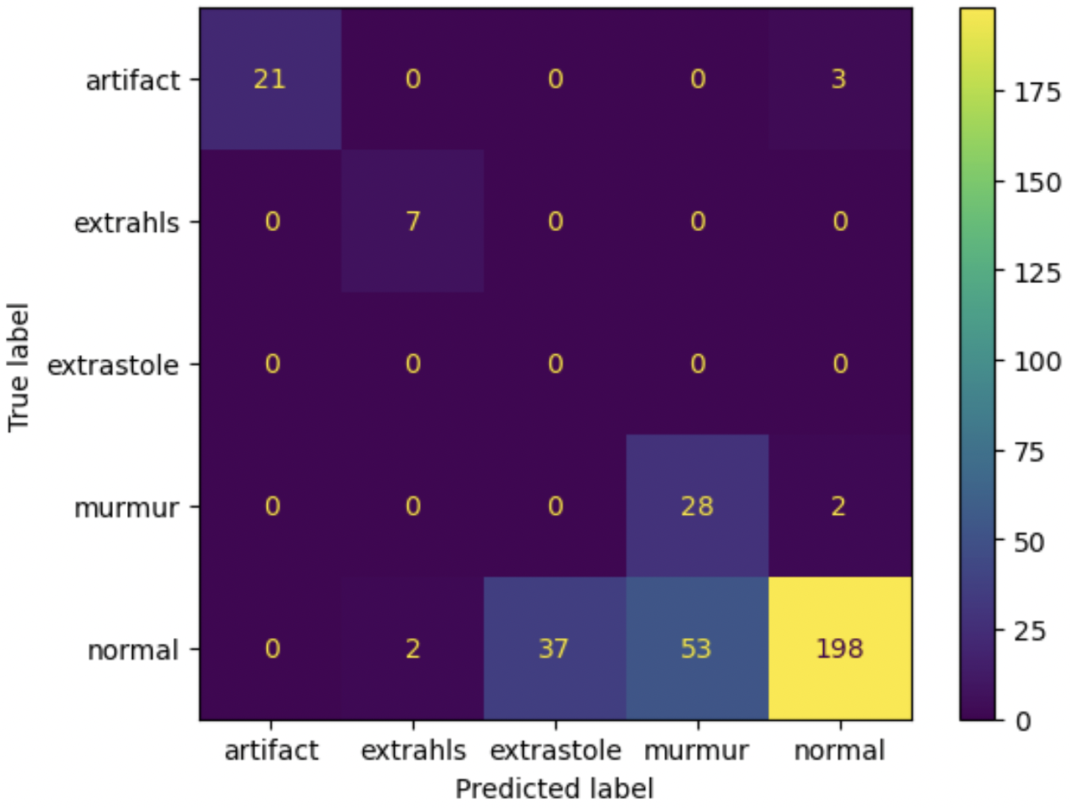
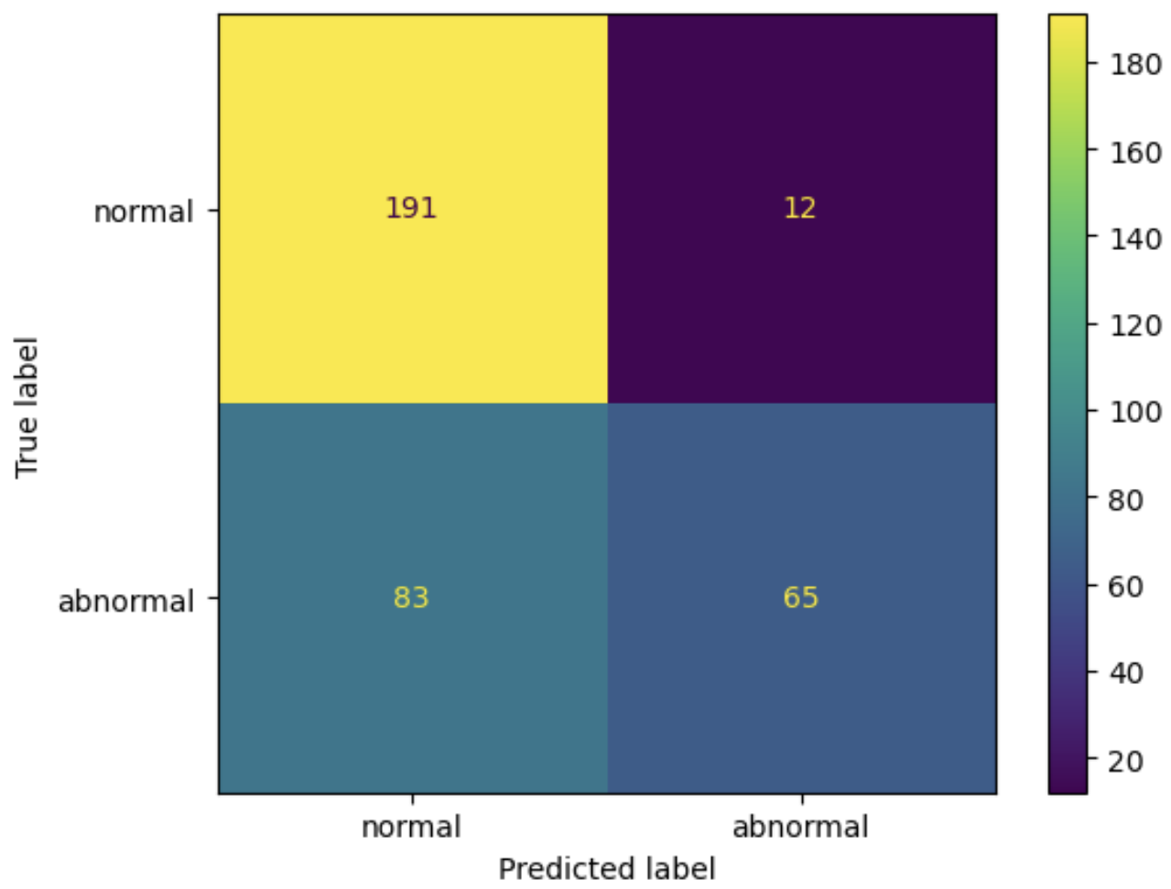
Modeling – CNN (1D)
5 Classes
Binary
Accuracy = 72.93%
Precision = 84.42%
Recall = 43.92%
F1 Score = 57.78%
The CNN model is made up of 6 layers of 'ReLU' Activation Functions and a 'Softmax' Activation in the final layer.
Comments
Accuracy = 72.36%

Slide 18
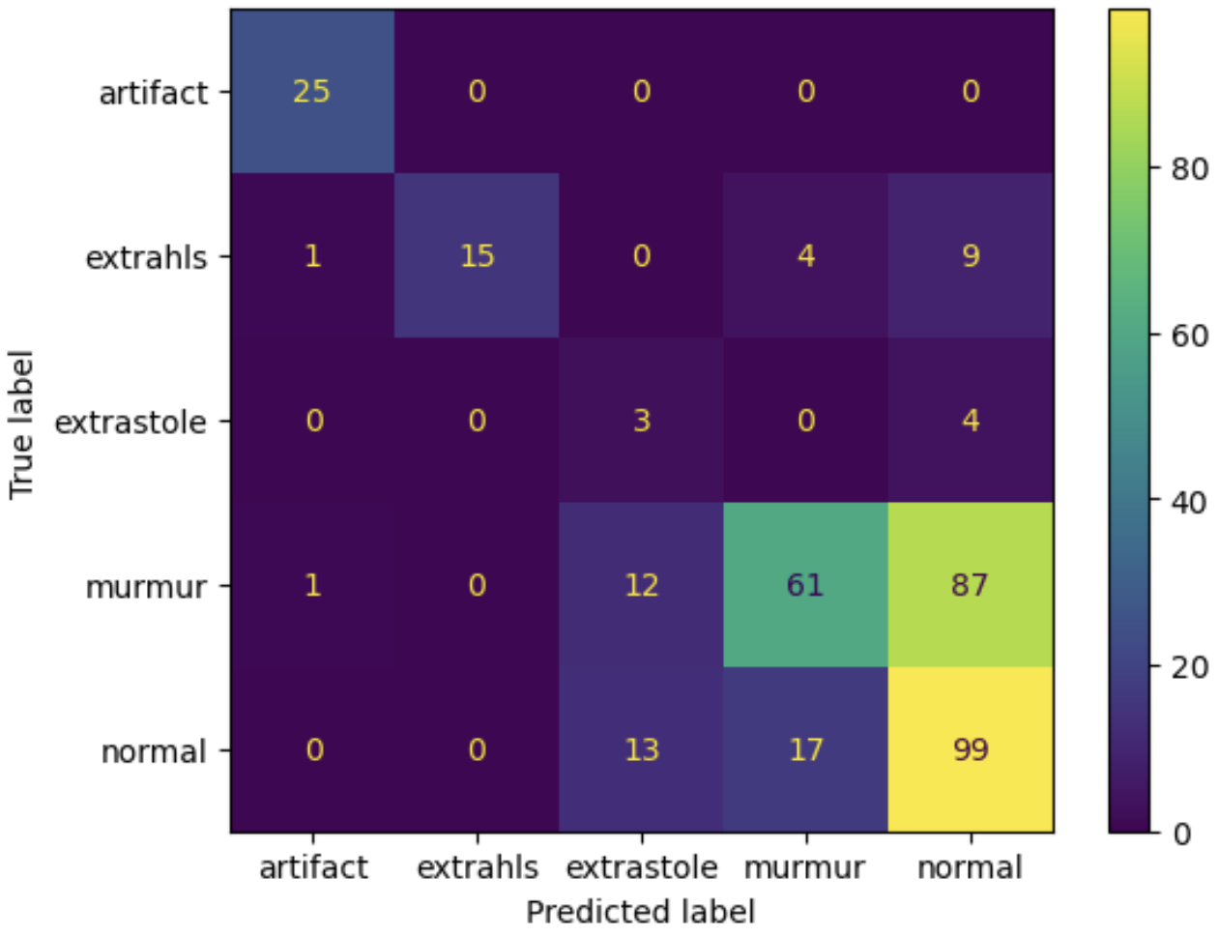
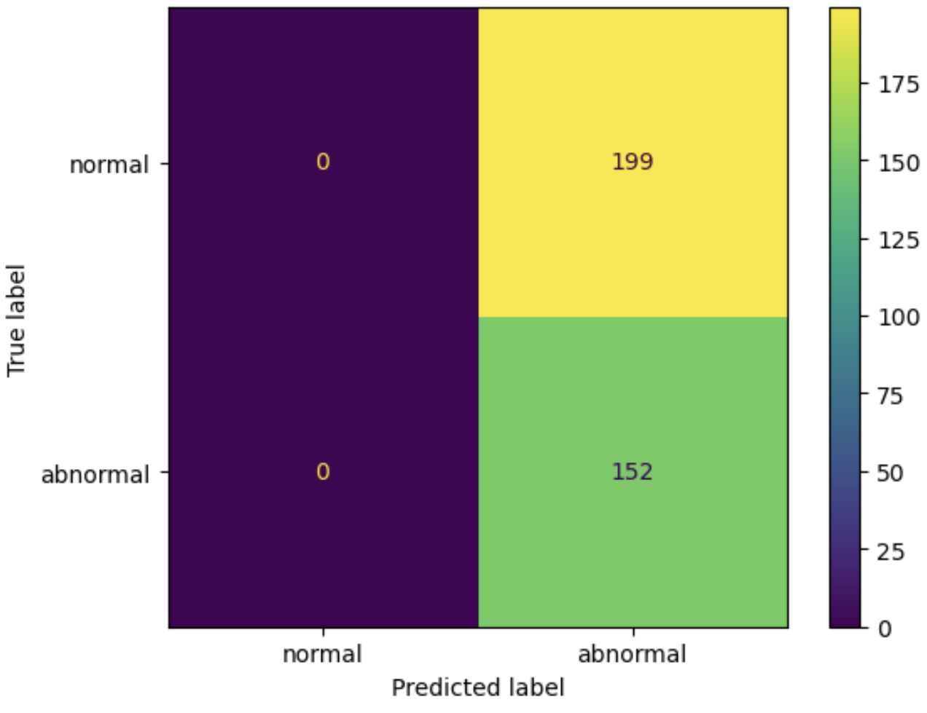
Modeling – CNN (1D) - UpSampled Training Data
5 Classes
Binary
Accuracy = 43.3%
Precision = 43.3%
Recall = 100%
F1 Score = 60.44%
Upsampling degraded the performance of the model.
Comments
Accuracy = 57.83%

Slide 19
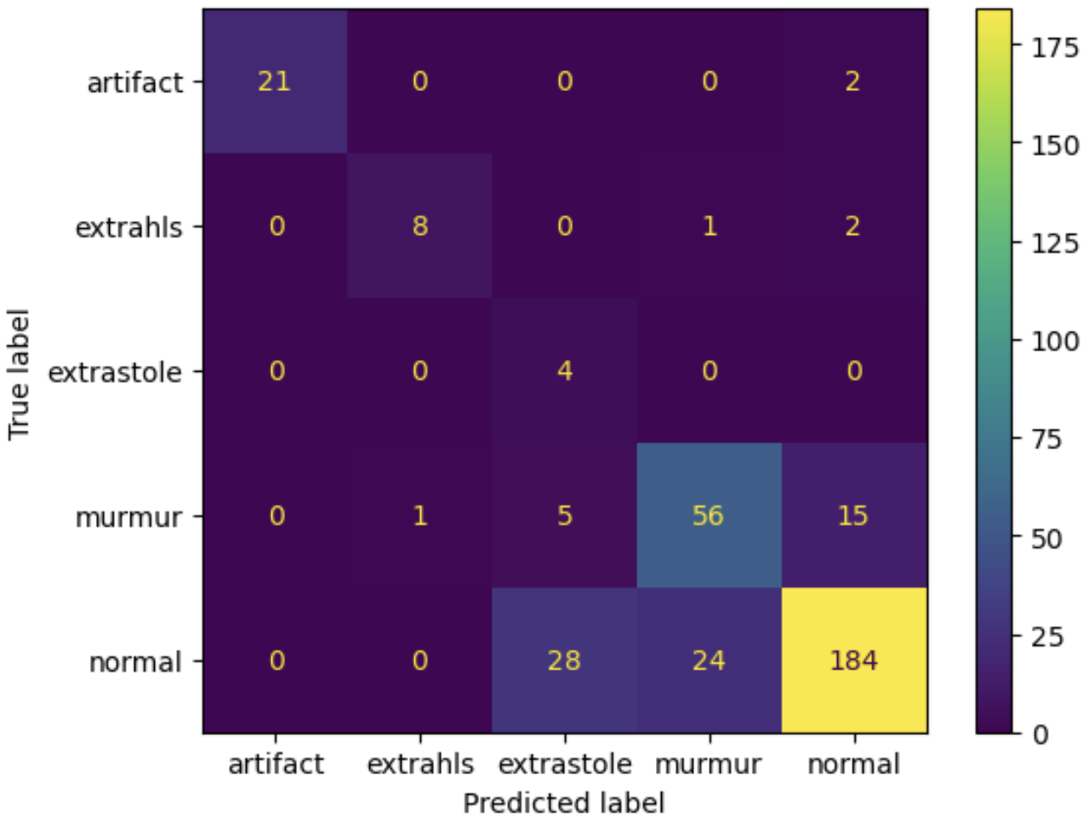

Modeling – CNN2 (1D)
5 Classes
Binary
Accuracy = 78.63%
Precision = 78.74%
Recall = 67.57%
F1 Score = 72.73%
Added complexity into the model in the form of 'Tanh' activations
Comments
Accuracy = 77.78%

Slide 20
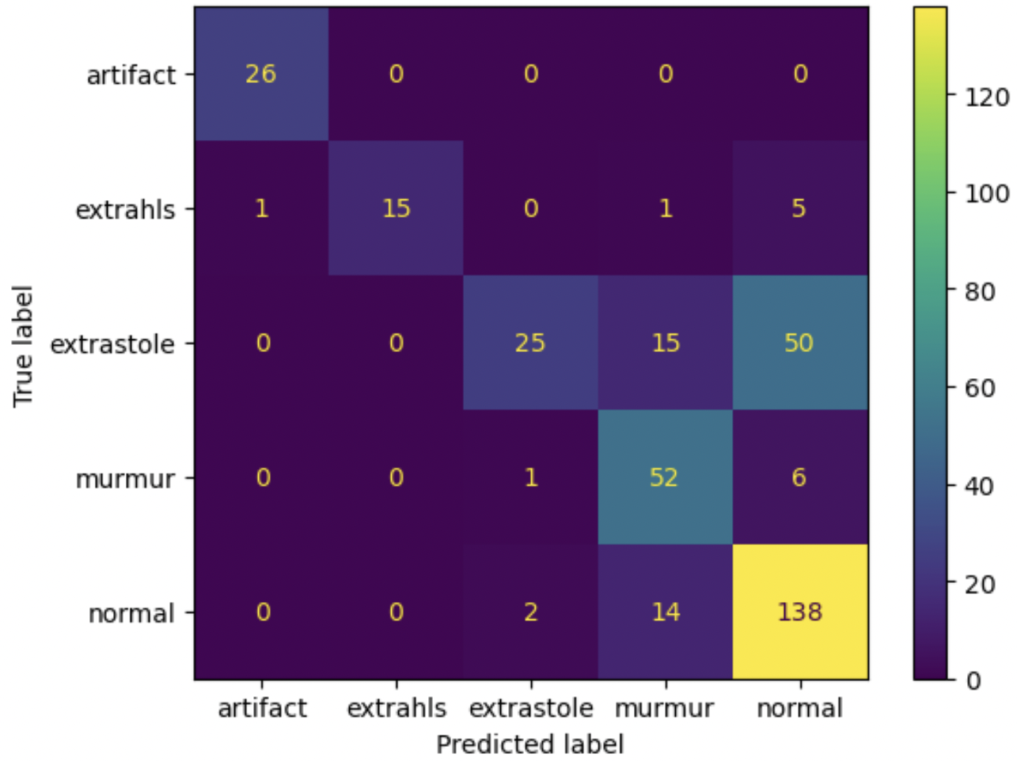
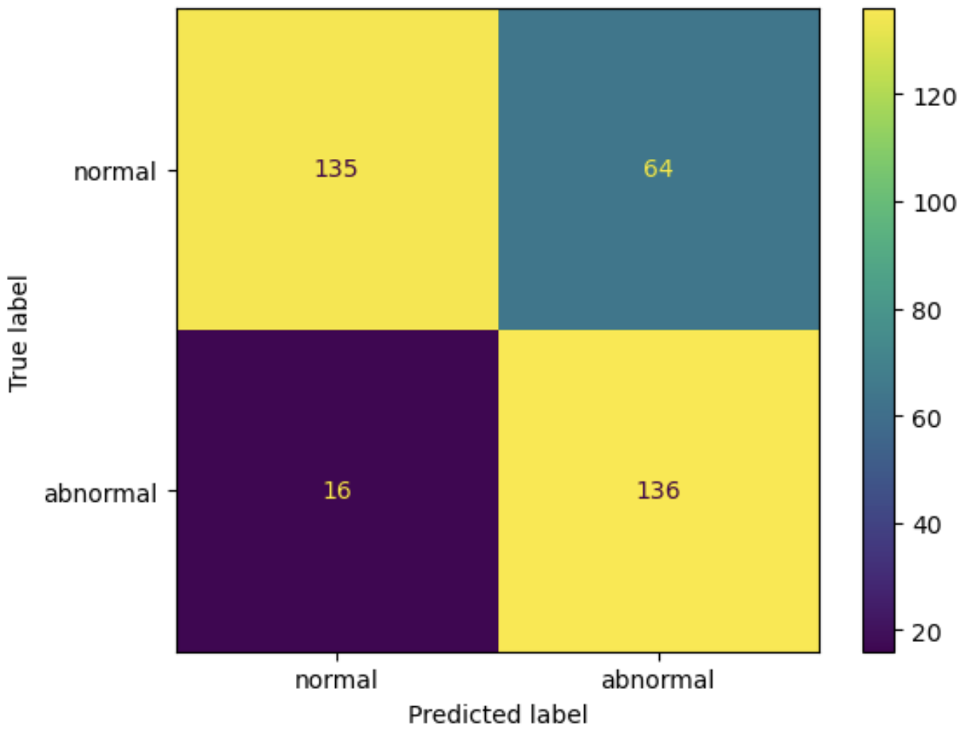
Modeling – CNN2 (1D) - UpSampled Training Data
5 Classes
Binary
Accuracy = 77.21%
Precision = 68%
Recall = 89.47%
F1 Score = 77.27%
UpSampling reduced the accuracy but improved F1 score
Comments
Accuracy = 72.93%

Slide 21
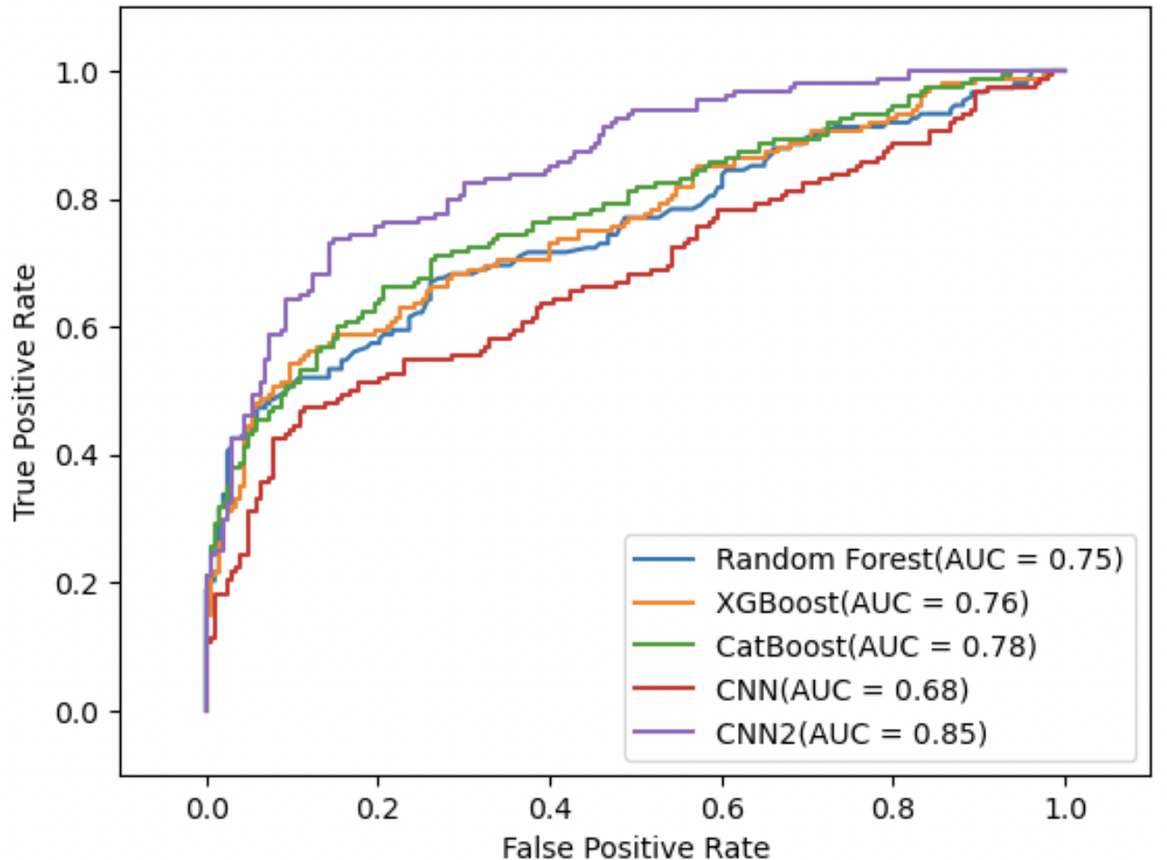
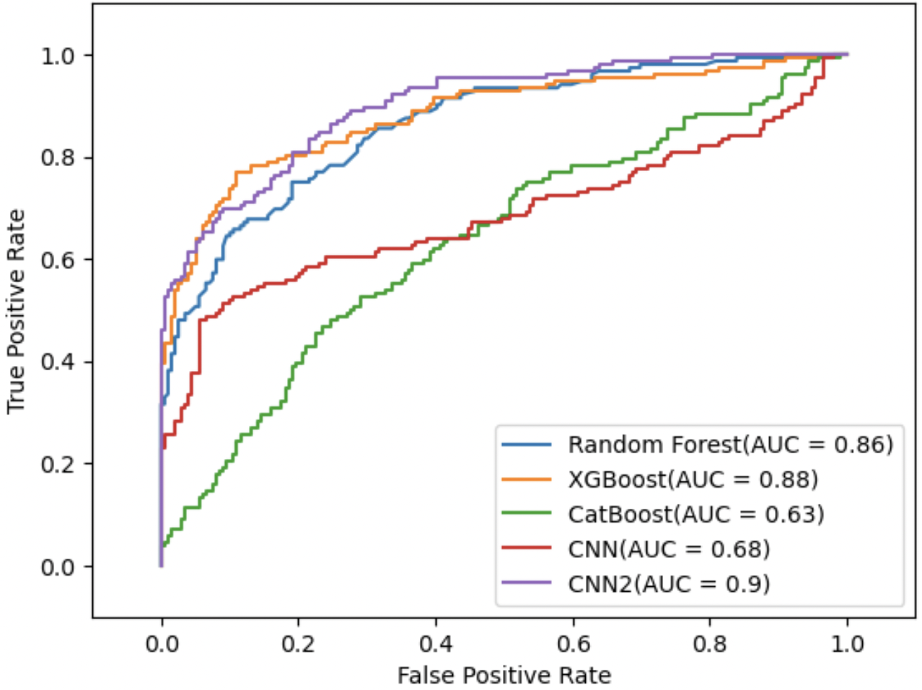
ROC-AUC
Imbalanced Training Data
Resampled Training Data

Slide 22
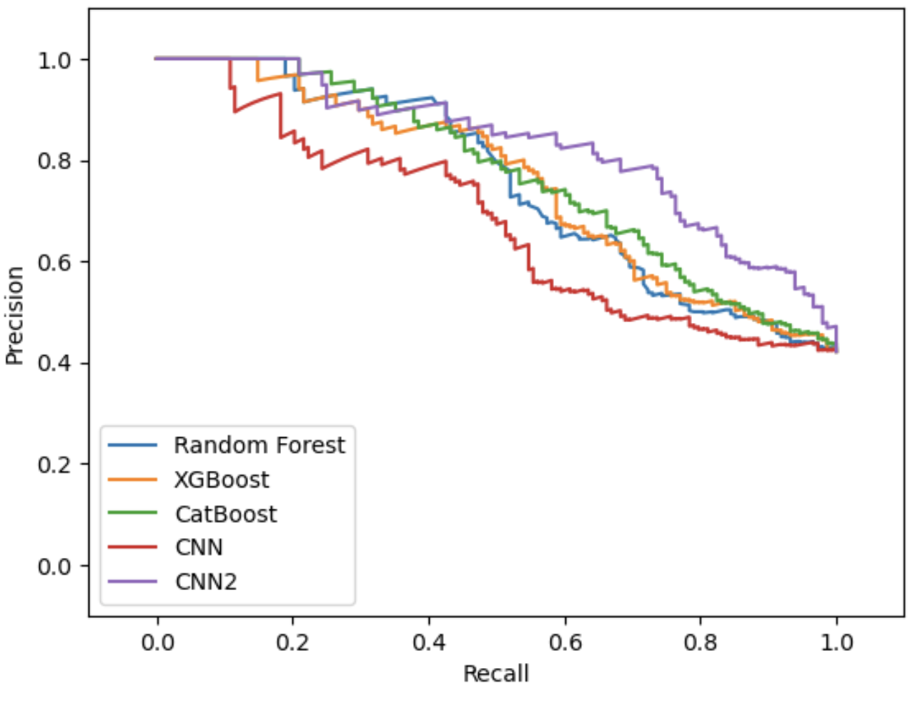
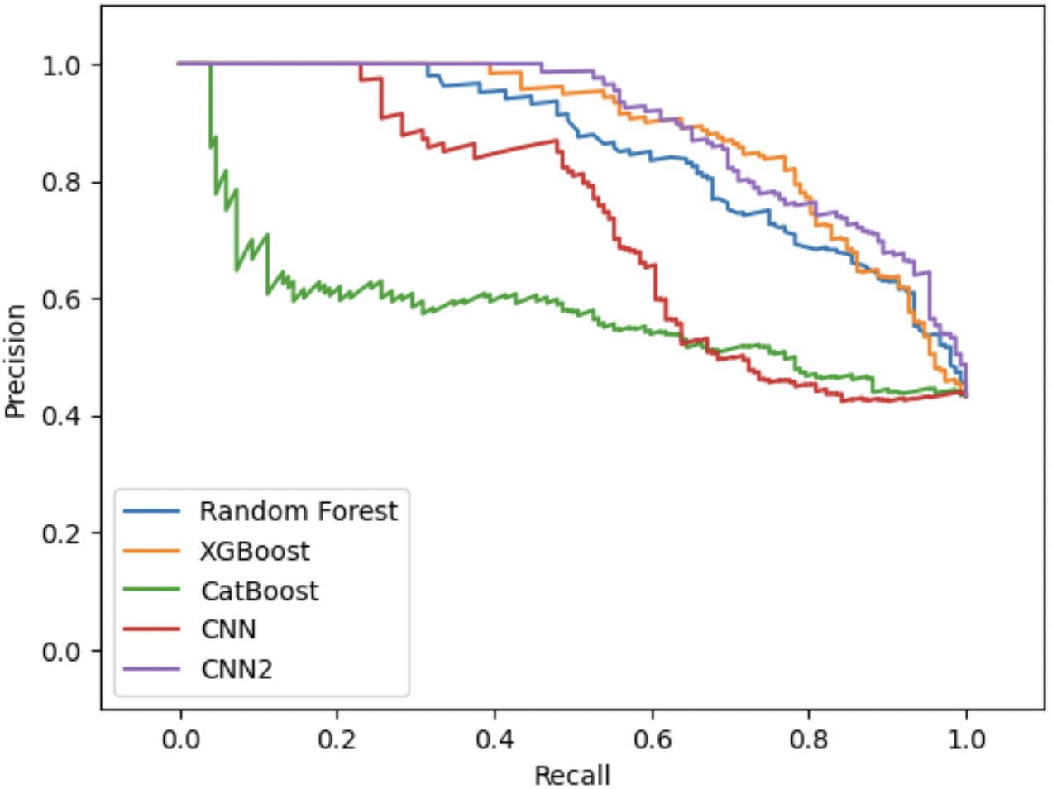
Precision - Recall
Imbalanced Training Data
Resampled Training Data

Slide 23

Next Steps:
Improve the Neural Network performance further
Deal with class Imbalance
Compare with other non-invasive technologies to detect the abnormalities
Deploy the model on AWS (Additional Scope)

Slide 24


Slide 25
REFERENCES
Dataset: http://www.peterjbentley.com/heartchallenge/
National Library of Medicine: https://www.ncbi.nlm.nih.gov/pmc/articles/PMC8229456/

